Slide 1
Modeling and Monitoring social media dynamics to predict short-term peak electricity demand
Isabella Grieser, T. Gebhard, A. Tundis, J. Kersten, T. Elßner, F. Steinke

Slide 2
Contents
Motivation
Methodology
Modeling the Impact of Social Media on Power Demand
Estimation Algorithm for the Information Spread with Social Media Data
Case Study: Social Media Misinformation Risks in Dynamic Energy Pricing
Conclusion

Slide 3
Motivation

Slide 4
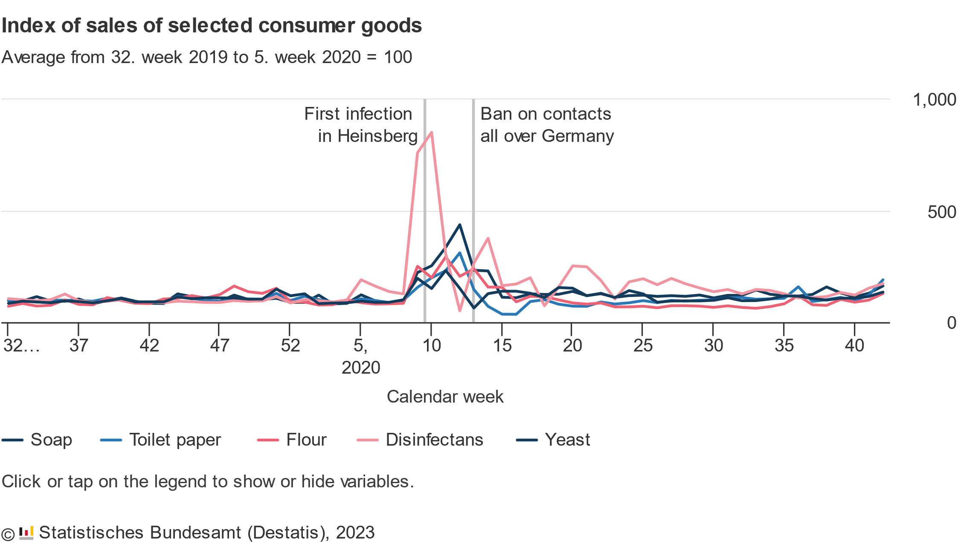
Panic Buying and Overconsumption became a prominent topic during the COVID-19 Pandemic
Panic Buying: When consumers buy unusually large amounts of a product due to a (perceived) crisis
During the COVID-19 Pandemic: People bought much greater number of disinfectants and soap in fear of the infectious disease.
Panic was amplified due to Information on Social Media
Notes:
During the COVID-19 pandemic, a significant part of the population stockpiled on essential goods such as disinfectant, soap or toilet paper.
This was caused bz a phenomenom called panic buying, where consumers buy an unusual amount of specific goods due to a specific crisis, which can be imagined or not
Panic buying occured dring the COVID 19 pandemic, but there were other instances of it occuring in the past, for example to prepare for hurricanes.
One of the reasons for panic buying was social media. Consumers see articles from news sites of shortages or see posts from friends about their own experiences in the shortage and get affected by them, feeling the pressure of the situation and forcing them to act and to stockpile
Social media induced panic buying onlz occured with physical goods. But ➔ Could it also affect critical infrastruture such as the power grid?
Until now, there seems to be no mjor incidents where social media cause significant changes in power demand.
However, there are some scenarios where this could happen.

Slide 5
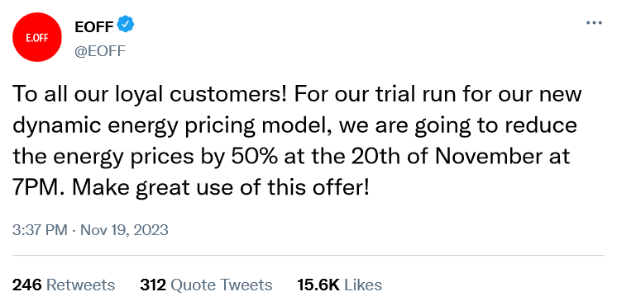
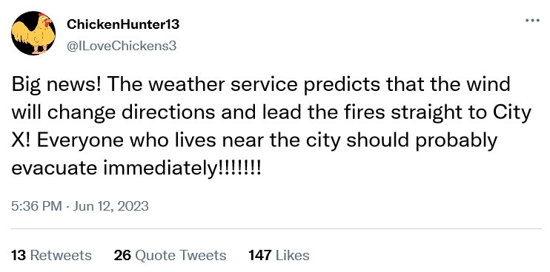
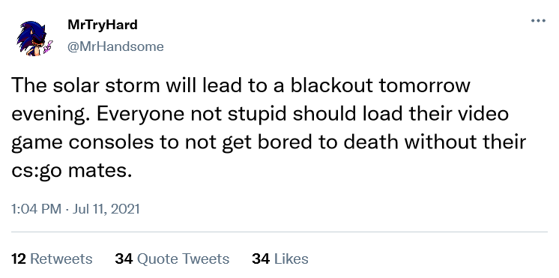
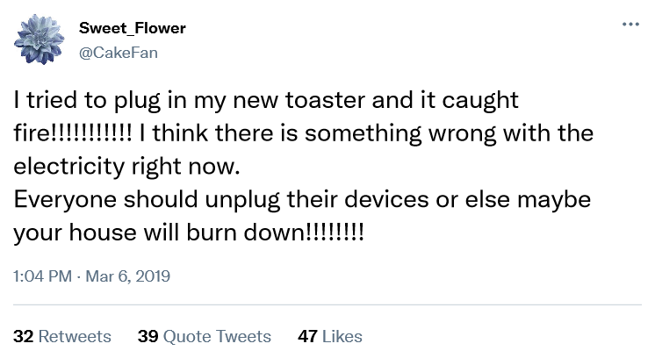
Could Social Media affect Power Demand?
Notes:
Weiss nicht ob ich dieses slide zeigen soll

Slide 6
One theoretical Scenario where Information on Social Media could affect Power Demand
Demand Response Scenario:
Malicious actors compromise the social media channels of an electricity company
and spread the false advertisement of reduced electricity prices for a limited time.
But: other scenarios could be imagined ….
Notes:
One scenario analysed in this work is the demand response scenario:
In this scenario: utility company uses dynamic pricing to adapt energy prices to changes in energy supply. They use social media to communicate price changes
But: if malicious actors take control of social media channels and spread the misinformation that the electricity prices will be significantly reduced for a certain amount of time
If consumers are encouraged to use more energy at a time where the demand is already high ➔ risk of overstraining the grid ➔ possible blackout
This is the scenario that we analysed in our work ➔ but: other scenarios could be imagined

Slide 7
Proposal for a Monitoring Framework
Collect Social Media Posts
Predict Model Parameters
Run Simulation
Predict Critical Peak Electricity Demand Trend
Notes:
We propose a framework to monitor and warn of such changes in power consumption based of social media posts in advance
Framework has 4 steps:
1.

Slide 8
Methodology - Modeling the Impact of Social Media on Power Demand
Notes:
Now I am going to introduce our approach to model the effects of social media on the power grid

Slide 9
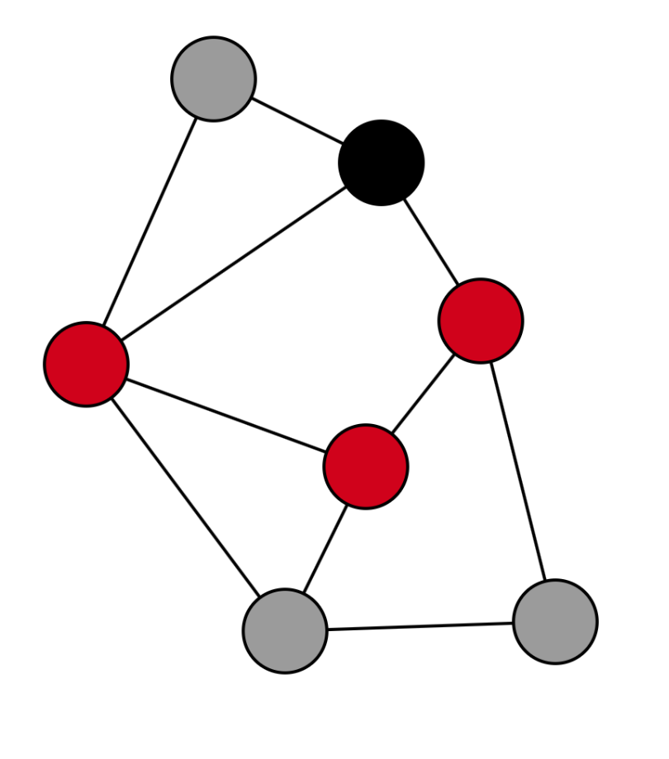
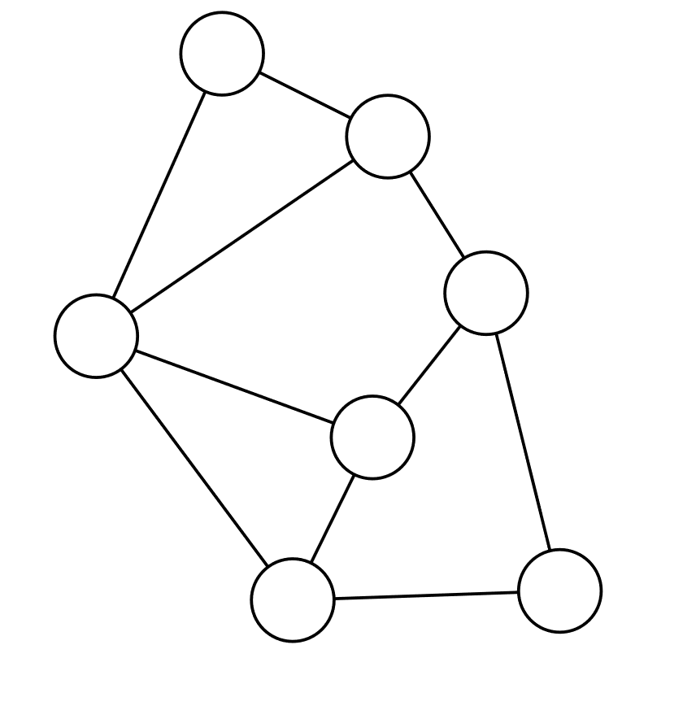
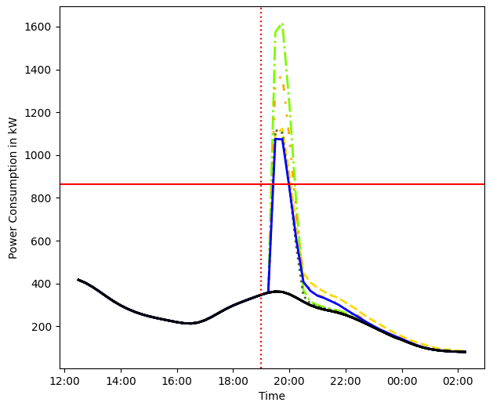
Idea: Analyze the Effects of Information Flow on the Power Grid
Social Media Graph
Information Diffusion Model
Power Demand Simulation Rules

Slide 10

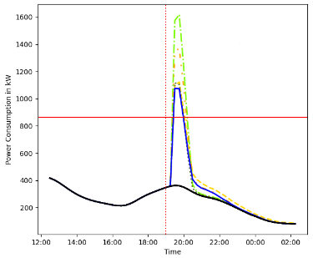
The Social Media Network Graph is modelled via Random Graph Algorithms
Graph model used to model social media networks ➔ Barabási–Albert model
Small world
Scale-free networks
Highly clustered
The SIR model is used to model the information propagation process:
Three states:
Susceptible (S)
Infected (I)
Recovered (R)
Notes:
Modell genauer erklären -> was ist meine contribution
Gif von state changes sir
Betonen: epidemologisches Modell -> information ist eine infektion

Slide 11




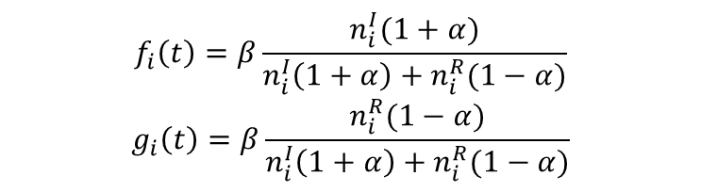


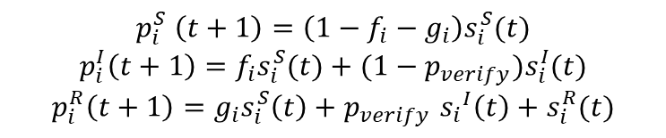
Formulas of the SIR model
State Chart
$${1−g}_{neighbors}−f_{neighbors}$$
Susceptible
$$g_{neighbors}$$
$$f_{neighbors}$$
Recovered
Infected
$$p_{verify}$$
$$1$$
$$1−p_{verify}$$
$$f_{i}\left(t\right)=β\frac{n_{i}^{I}(1+α)}{n_{i}^{I}\left(1+α\right)+n_{i}^{R}(1−α)}$$
$$g_{i}\left(t\right)=β\frac{n_{i}^{R}(1−α)}{n_{i}^{I}\left(1+α\right)+n_{i}^{R}(1−α)}$$
$$p_{i}^{S} \left(t+1\right)=\left(1−f_{i}−g_{i}\right)s_{i}^{S}(t)$$
$$p_{i}^{I}\left(t+1\right)=f_{i}s_{i}^{S}(t)+(1−p_{verify})s_{i}^{I}(t)$$
$$p_{i}^{R}\left(t+1\right)=g_{i}s_{i}^{S}\left(t\right)+p_{verify} {s_{i}}^{I}\left(t\right)+s_{i}^{R}(t)$$
Notes:
Graphbasiertes sir erklären

Slide 12
Simulation Rules to analyze the Effects on the Power Grid
Assumptions
Each node in the social media graph represents one (physical) household
Only infected entities change their electricity demand
The effect of the information may have a delayed response on the electrical grid
Simulation Steps
Start with one source of information
For each iteration step
Calculate the power used in the network
Spread the information in the graph
Notes:
Power calculation auch gut erklären
Und assumption
Zweite assumption nicht erklären

Slide 13
Simulation Rules to analyze the Effects on the Power Grid
Power Calculation
Power usage is computed as the normal power consumption + the additional demand:
Reference power consumption defined with standard load profiles
Each household may have specific electrical appliances given their adoption rate
Households turn on all relevant electrical appliances
Each appliance consumes a constant amount of energy
Notes:
Power calculation auch gut erklären
Und assumption
Zweite assumption nicht erklären

Slide 14
Methodology - Estimation Algorithm for the Information Spread with Social Media Data

Slide 15
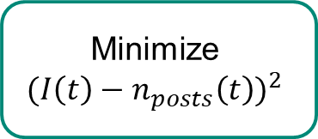
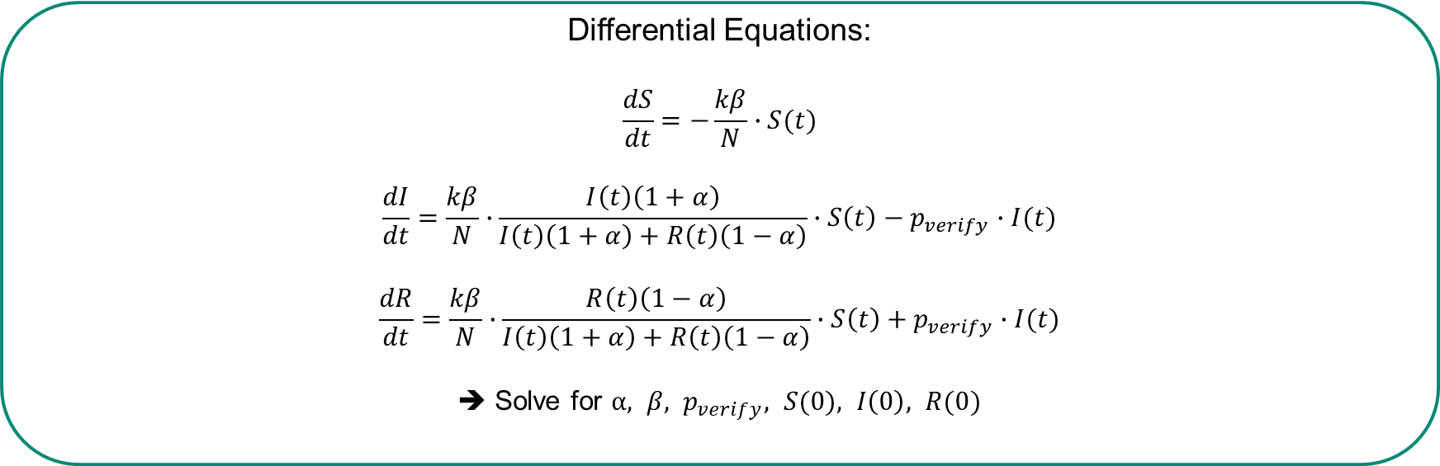
Social Media Data can be used to estimate Simulation Parameters
Count Social Media Posts over a Timespan
Smooth Data Plot
Minimize
$${(I\left(t\right)−n_{posts}\left(t\right))}^{2}$$
Solve Differential Equations
Differential Equations:
$$\frac{dS}{dt}=−\frac{kβ}{N}∙S(t)$$
$$\frac{dI}{dt}=\frac{kβ}{N}∙\frac{I\left(t\right)\left(1+α\right)}{I\left(t\right)\left(1+α\right)+R\left(t\right)\left(1−α\right)}∙S\left(t\right)−p_{verify}∙I(t)$$
$$\frac{dR}{dt}=\frac{kβ}{N}∙\frac{R\left(t\right)\left(1−α\right)}{I\left(t\right)\left(1+α\right)+R\left(t\right)\left(1−α\right)}∙S\left(t\right)+p_{verify}∙I(t)$$
➔ Solve for $α, β, p_{verify}, S(0), I\left(0\right), R(0)$
Notes:
Mean field theory

Slide 16
Case Study

Slide 17
Scenario 1: Demand Response Scenario
Assumptions
Many people believe and will act on the information
Infected entities have a delayed response, acting after the time specified in the social media message
Infected entities will turn on many energy-intensive appliances (dishwasher, washing machine, …) in their households
Number of entities: 1000, time resolution: 30 minutes
Demand Response Scenario
A false advertisement for reduced electricity price for a limited time spreads through social media.
Notes:
Ladeleistung erlkären
Anzahl an entities nennen

Slide 18
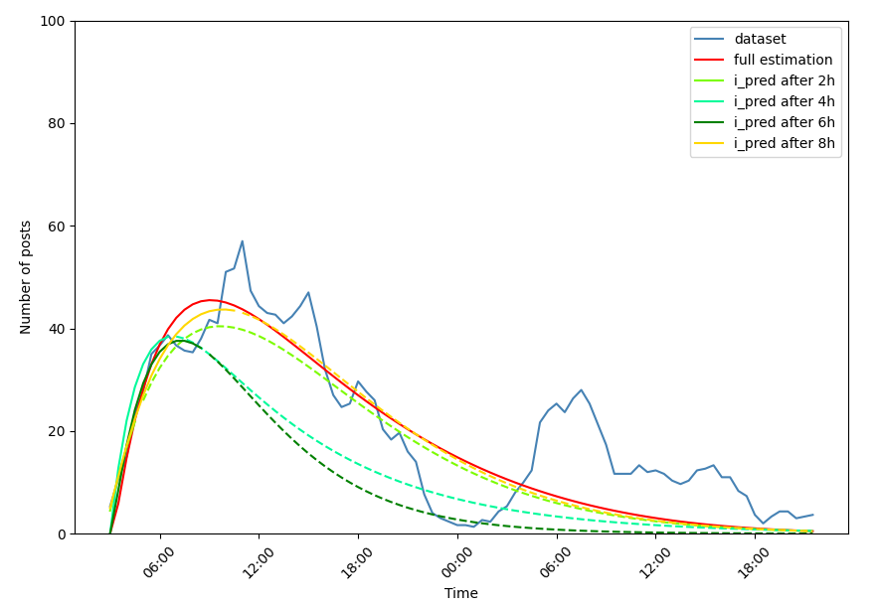
Information Propagation Parameter Estimation
Social Media Dataset
Grunewald fire
Tweets gathered between August 4th, 2022, and August 5th, 2022
Tweets contained the keywords ” Grunewald”, ”fire”, ”explosion”, or ”bomb”
In total 1759 tweets

Slide 19
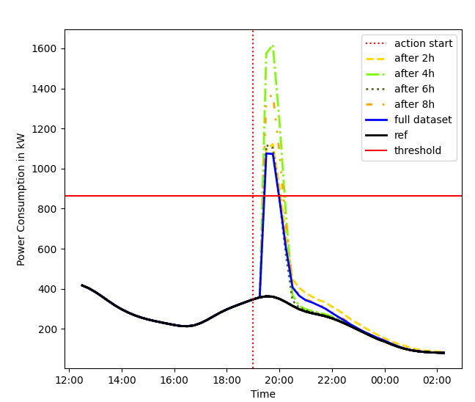
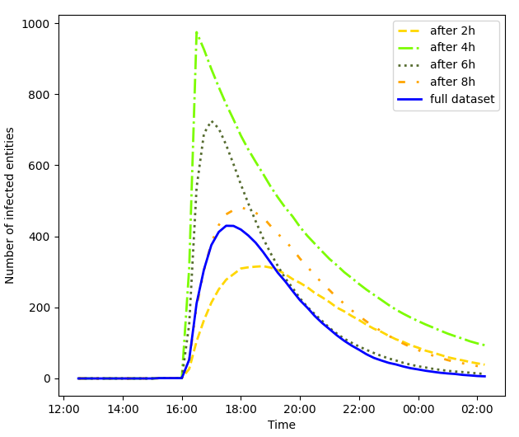
Simulated Infection Process and Power Consumption

Slide 20
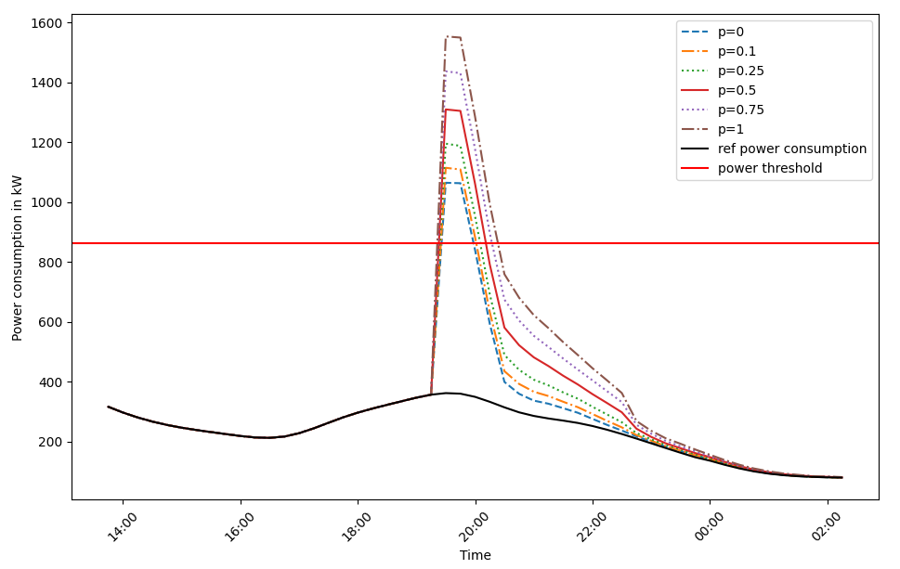
Changes in Power Consumption with a variable adoption rate for EVs
Notes:
Hier p zu adoption rate ändern

Slide 21
Conclusion

Slide 22
Conclusion
Synchronization events caused by information on social media could be critical to the power grid
Increasing adoption of new, highly power-consuming technologies could increase the peak power demand caused by synchronization

Slide 23
Questions?

